Slide 1

Resume Screening

Slide 2


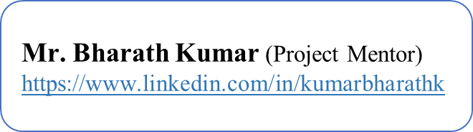
Project Leadership
MR.Sharat Manikonda
Director at Innodatatics and Sponsor
linkedin.com/in/sharat-chandra

Slide 3


Team Member
Valarmathi Jayaraj

Slide 4
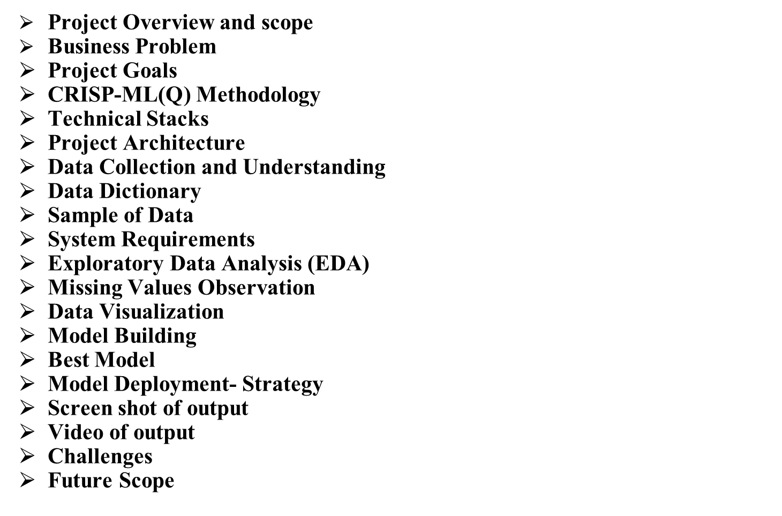
Contents

Slide 5
Project Overview and Scope
Project Overview:
The resume screening project is an automated system that can quickly and accurately screen job applications, identify relevant skills and experience, and rank candidates based on their fit for the job, while minimizing bias and ensuring fairness.
Business Objectives:
•Maximizing the profits (Time and cost save)
•Minimize the Bias.
Business Constraints:
Inaccurate screening:
Limited access to high-quality training data- The performance of a resume screening system depends heavily on the quality of the training data used to train the model.
Resistance to change
Cost.

Slide 6
Business Problem
This project aims to solve is the inefficiency and subjectivity of the traditional recruitment process. Human recruiters typically spend a significant amount of time manually reviewing and screening resumes, which can be time-consuming and costly. Additionally, human recruiters may be subject to unconscious bias, leading to the selection of candidates based on subjective factors rather than objective qualifications.
Success criteria
Business Success Criteria: To make the business successful and then the growth yearly at least by 5%.
ML Success Criteria: To build a model with more than 90% accuracy.
Economic success criteria: To increase the accuracy in identifying the most qualified candidates:

Slide 7
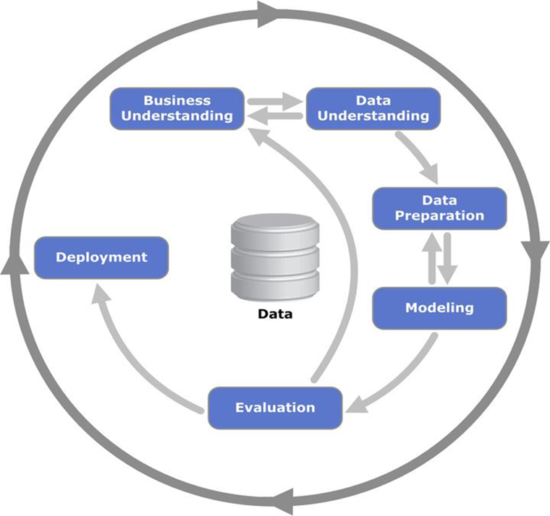
CRISP-ML(Q) Methodology
CRISP-ML(Q) – Cross Industry Standard Process For machine Learning With Quality Assurance
CRISP-ML(Q) process model describes six phases:
•Business and Data Understanding
•Data Engineering (Data Preparation)
•Machine Learning Model Engineering
•Quality Assurance for Machine Learning Applications
•Deployment
•Monitoring and Maintenance.

Slide 8






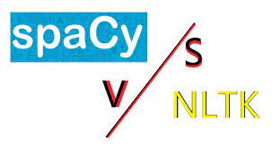


Technical Stacks

Slide 9
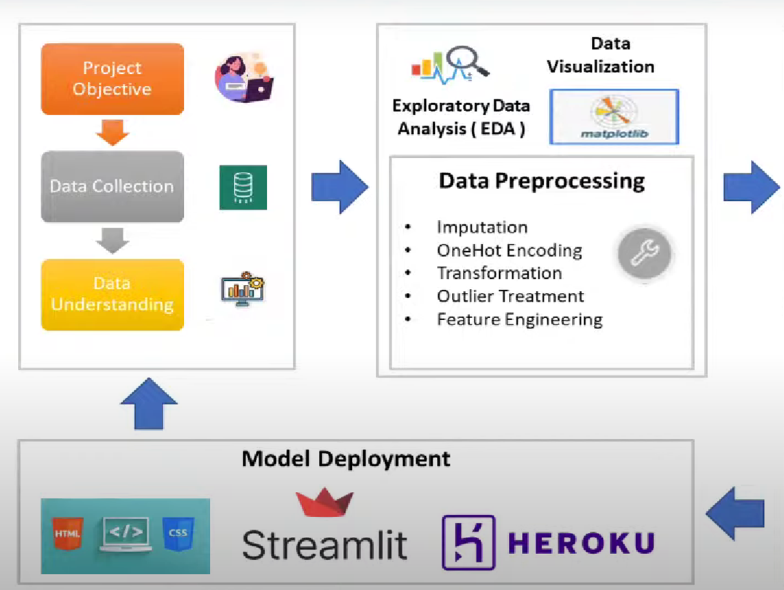
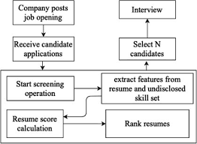

Project Architecture

Slide 10
Data Collection and Understanding
•Understand the product requirement.
•Extracted appropriated data for the selected features by using web scraping .
•Features or attributes were collected by going through Similar kind of Projects and Objectives.
•pre-processed the collected data by performing few modifications and later built a model.
•Create a ‘.csv’ file in SQL to build the model.

Slide 11
Data Description

Slide 12
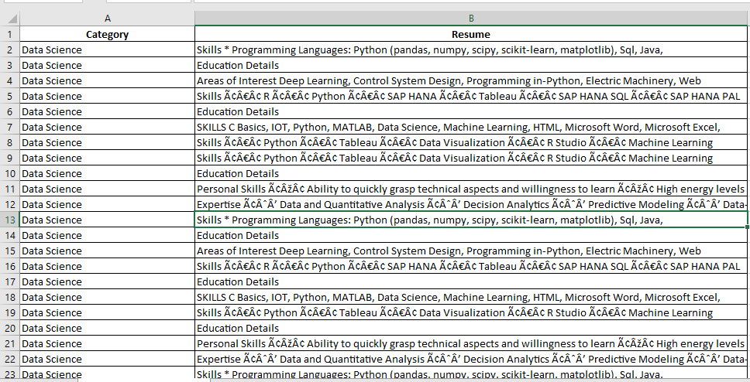
Data sample

Slide 13
Data Preprocessing
Exploratory Data Analysis
Preprocessing in a resume screening project typically involves several steps to clean, transform, and prepare the raw resume and job description data for use in machine learning models. Some common preprocessing steps include:
Data cleaning: This step involves removing irrelevant or redundant data from the resumes, such as images or special characters that may interfere with the machine learning model's ability to process the text.
Text normalization: This step involves standardizing the text format across all resumes and job descriptions to make them consistent. This can include converting all text to lowercase or uppercase, removing punctuation marks, and stemming or lemmatizing words to group together similar words.
Tokenization: This step involves splitting the resumes and job descriptions into individual words, or tokens. Tokenization allows the machine learning model to analyze the text at the word level.

Slide 14
Exploratory Data Analysis
Stop words: are words that are commonly used in natural language but do not carry much meaning on their own, such as "the," "a," "an," "and," and "in." In machine learning, stop words are often removed from text data before training a model to improve accuracy and reduce noise.
Word clouds : Word clouds are a visualization technique that is commonly used in machine learning to explore and analyze text data. A word cloud is a graphical representation of text data, where the size of each word represents its frequency or importance within the text.

Slide 15


Feature Engineering
Feature engineering is an important step in a resume screening project to extract relevant features from the data and improve the accuracy of the machine learning models.
Notes:
EDA is used for seeing what the data can tell us before the modeling task.
Change

Slide 16
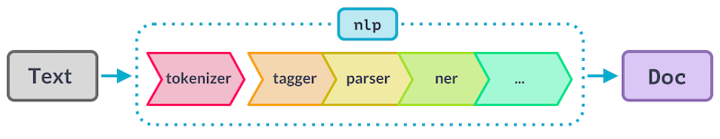
Feature Engineering
Pipelines are combined together in order to pre-process categorical features in the dataset and add the regressor.
After this step the raw data will be cleaned and it gets ready for the model building part.

Slide 17
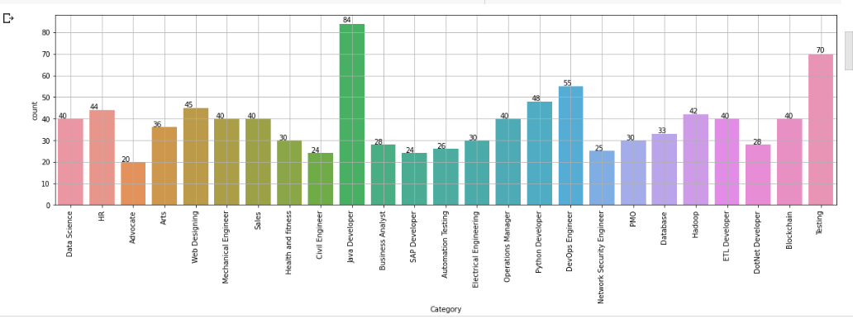
Data Visualization
The information that is draw from the line chart of sales is;
There is upward trend in the data.
The data has seasonality in it.
Notes:
Keep observations

Slide 18
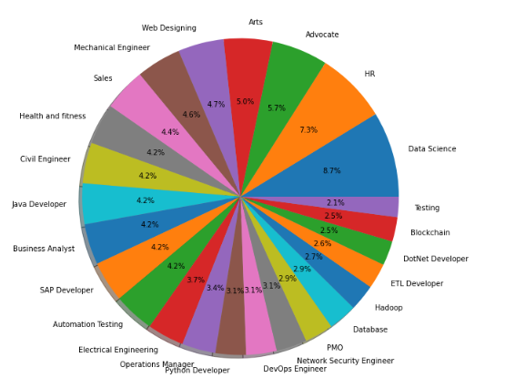
Data Visualization
Notes:
Keep observations

Slide 19
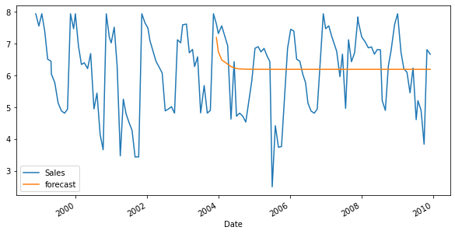
Model Building
2.Univariate time series model with ARIMA
Arima model stands for stands for Auto-Regressive Integrated
Moving Average.
we used a time series forecasting to predict the future values.
So in arima model we first done log operation to smoothen exponential
curve.
Then we create a function that checked dataset stationarity which is
adf_test and in result we got the p value is greater than 0.05 It implies
that the time series is non-stationary. then to make the data set
stationary we perform the Augmented Dickey-Fuller test but it also
failed .
From the output above
The blue line is the actual monthly sales. The orange line is the forecast sales. The ARIMA model has not performed well since it has not made correct predictions. The orange line is far apart from the blue line. We will now build another time series model using SARIMA to improve the performance.

Slide 20
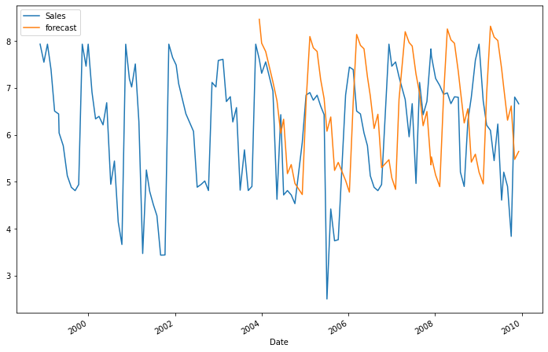
Model Building
3.SARIMA model
SARIMA will handle and model time series data with repeating cycles or seasonality.
-First we Training the SARIMA model,We use fit function to train the SARIMA model then we test the sarima model.
-Then We use Matplotlib to show the actual and the predicted (forecast) sales as follows:
-From the output above:
-The blue line is the actual monthly sales.The orange line is the forecast sales.
-The time series model had made correct predictions since the two lines are close together. The SARIMA model has performed well as compared to the ARIMA model.

Slide 21
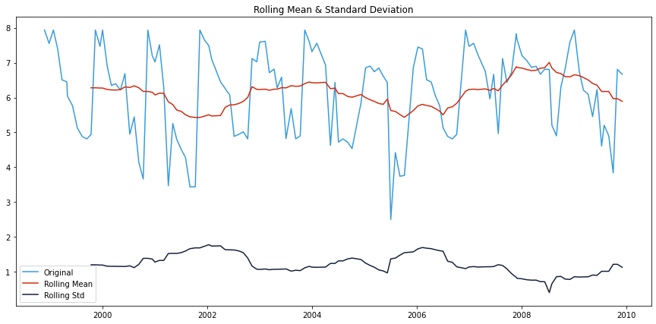
Model Building
- Rolling mean average and Rolling std
-A Rolling Moving Average is an additional type of Moving Average.
-In this figure the blue line shows the original sales values where the red line shows the Rolling mean average and the violet line shows the Rolling Standard Deviation.

Slide 22
Model Building
4.Auto Arima model
-An Autoregressive integrated moving average is a statistical analysis model that uses time series data to either better understanding the dataset and predict future trends based on past values.
-we have tried with the p, d, q values ranging from 0 to 5 to get better optimal values from the model.
The best model with using auto arima model
-Best model: ARIMA(0,1,1)(0,1,1)[12]
Total fit time: 10.057 seconds
-Used the trained model to forecast the sales on the test data.

Slide 23

Model Building
5.Exponential Smoothing, Holt Winter's Exponential Smoothing
Model building part is done by Exponential Smoothening as-
Exponential Smoothening: It is one of the rule of thumb technique for smoothing time series
data using the exponential window function. Whereas in the simple moving average the past
observations are weighted equally, exponential functions are used to assign exponentially
decreasing weights over time.
For this business problem, we have decided to apply Exponential Smoothening to forecast the
future values.
Various exponential model are applied such as Simple Exponential Smoothing, Holts Exponential Smoothing, Holt Winter's Exponential Smoothing.
We evaluated the model using MAPE(mean absolute percentage error) AND Holt Winter's Exponential
Smoothing with multiplicative seasonality and additive trend is giving us the less error.
Hence we have decided the Holt Winter's Exponential Smoothing is the
best for the business problem.

Slide 24
Best Model –
When come to the current model building, we have used Holt Winter's Exponential Smoothing as the finalized algorithm to get the forecasted values. Here comparing with the exponential smoothening model, Holt Winter's Exponential Smoothing with multiplicative seasonality and additive trend gives less error Metrics for the Holt Winter's Exponential Smoothing :
# Creating a function to calculate the MAPE value for test data
def MAPE(pred, org):
temp = np.abs((pred-org)/org)*100
return np.mean(temp)
mv_pred = cement["Sales"].rolling(4).mean()
mv_pred.tail(4)
MAPE(mv_pred.tail(4), Test.Sales)
Therefore the MAPE(Mean Absolute percentage error )is->
Out[172]: 32.415305450986466

Slide 25
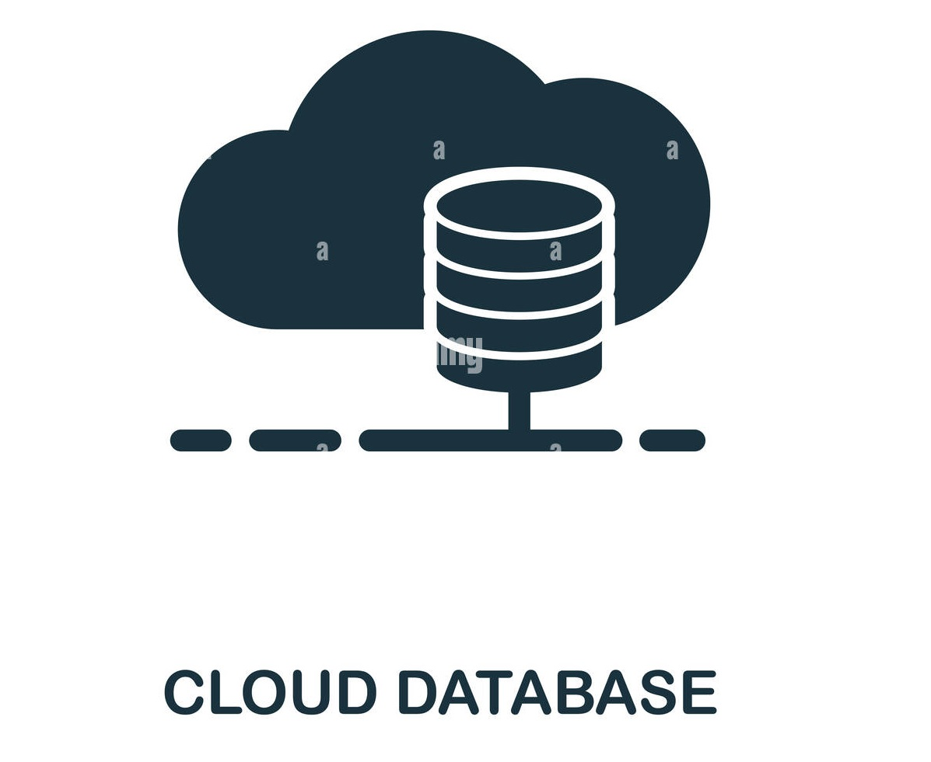
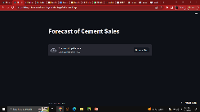





Model Deployment - Strategy
Model Deployment is done using Streamlit Cloud.
To Deploy the Model, we created an account in GitHub( GitHub is a for-profit company offering a cloud-based Git repository that helps developers store, manage, track and control changes).
Then we created Git repository in it uploaded required files.The required files are Procfile, requirements.txt, test.py, time series forecasting.py, setup.sh
Exponential
Smoothening
Model Building
Model Deployment

Slide 26
Screenshot of output

Slide 27
Video of output

Slide 28
Requirement
Python >=3.9
numpy>=1.15.4
pandas>=1.0.4
matplotlib>=2.0.0
convertdate>=2.1.2
cmdstanpy-0.9.5
Seaborn == 0.11.2
feature_engine==1.4.1
statsmodels==0.13.5
Install streamlit for model deployment, streamlit==1.18.1

Slide 29

Challenges
Resistance to change
Data collection and security
Language and cultural barriers
Missed opportunities
Privacy concerns

Slide 30

Future Scopes
Improved accuracy
Integration with Applicant Tracking Systems (ATS)
Bias elimination
Customization
Multilingual screening

Slide 31

Queries ?

Slide 32


